Slide 1
AGILE: Elastic Distributed Resource Scaling
For Infrastructure-as-a-Service
Anirudh Kaluri, Sagar Dama
CSC 724: Advanced Distributed System
Dr. Helen Gu
April 23,2024

Slide 2
INTRODUCTION

Slide 3
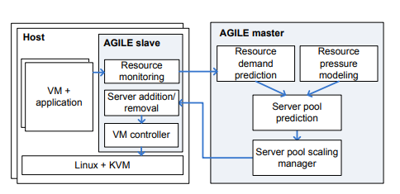
AGILE
Host:
Runs Virtual machines (VMs) with applications.
Managed by AGILE slave and Linux + KVM.
AGILE Slave:
Resource Monitoring: Continuously monitors VM resource
usage (CPU, memory, etc.).
VM Controller: Handles VM addition/removal and cloning.
AGILE Master:
Resource Demand Prediction: Uses wavelet transforms for
medium-term predictions.
Resource Pressure Modeling: Maps resource pressure to SLO violation rates.
Server Pool Scaling Manager: Manages server pool scaling
based on predictions.

Slide 4
OUR WORKFLOW, DESIGN AND DEPLOYMENT

Slide 5
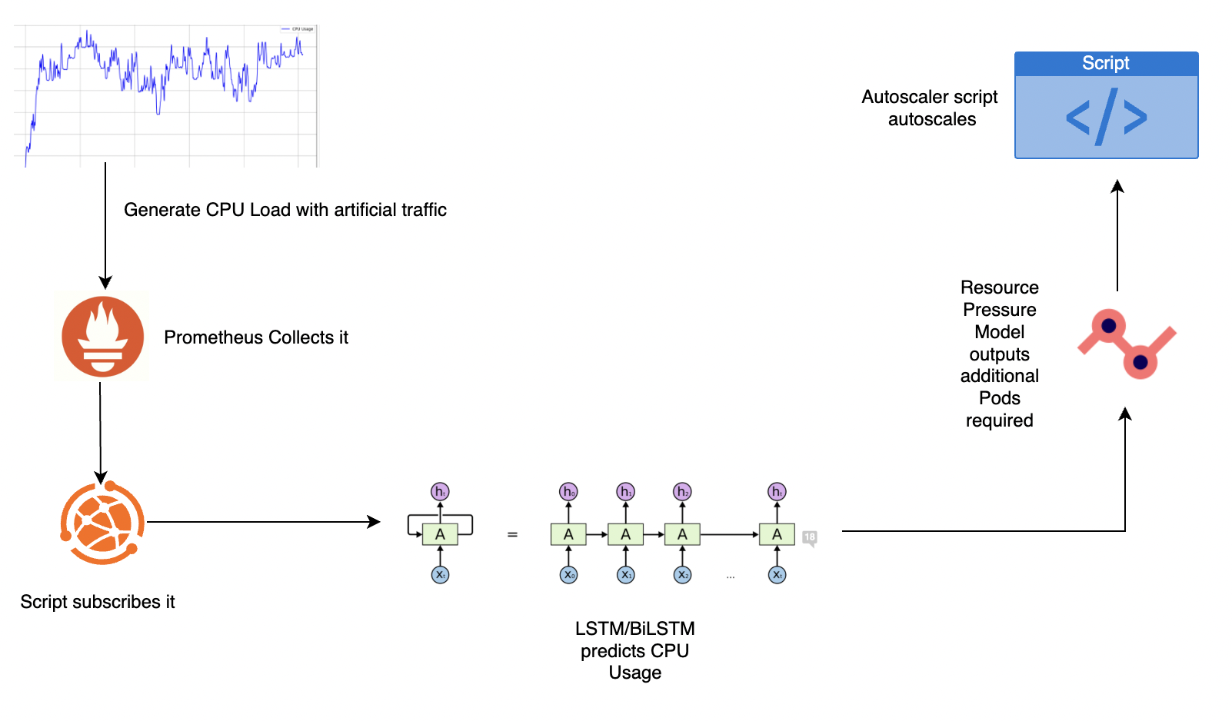
Workflow
Notes:
“Progress update” starts from here. give it to me

Slide 6
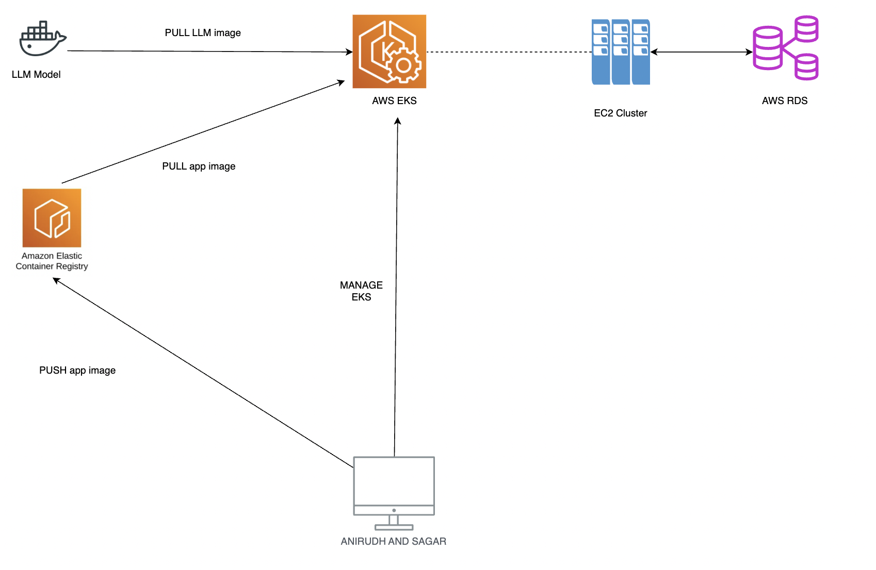
Our System Design

Slide 7
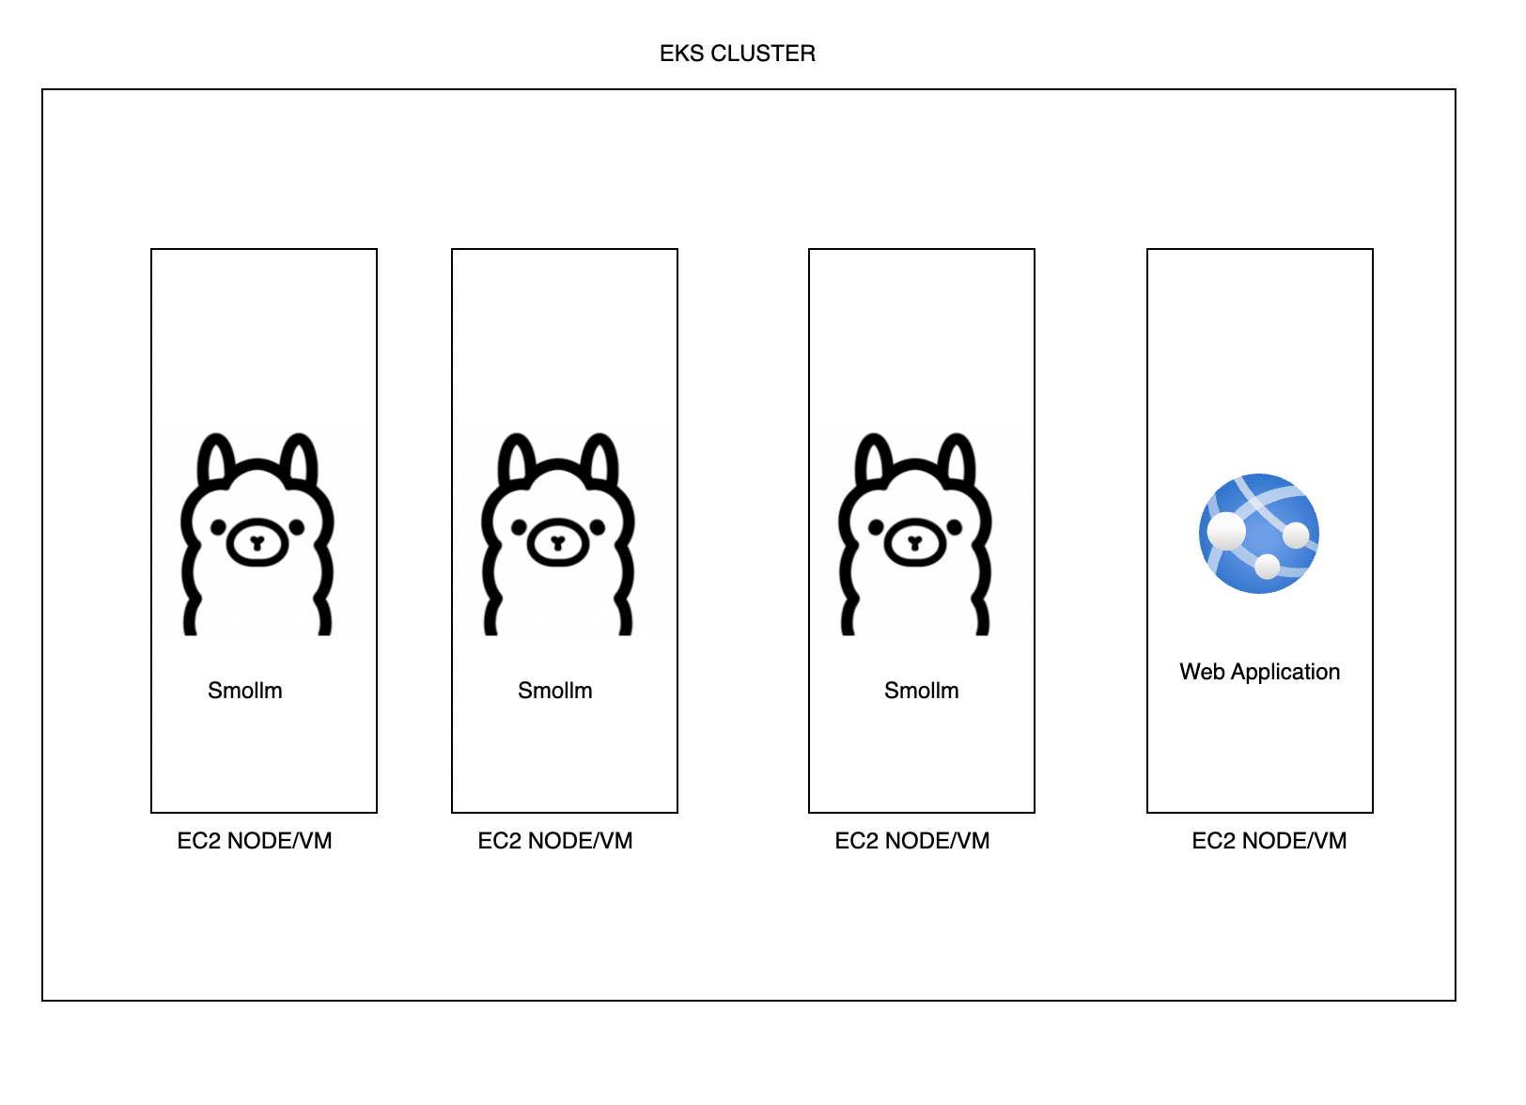
A closer look into our EC2
Type: M6I.xLarge, 4vCPUs, 16GB Memory
LLM: Smollm-135m
Web Application: Django Service, Gunicorn workers

Slide 8
EXPERIMENT

Slide 9
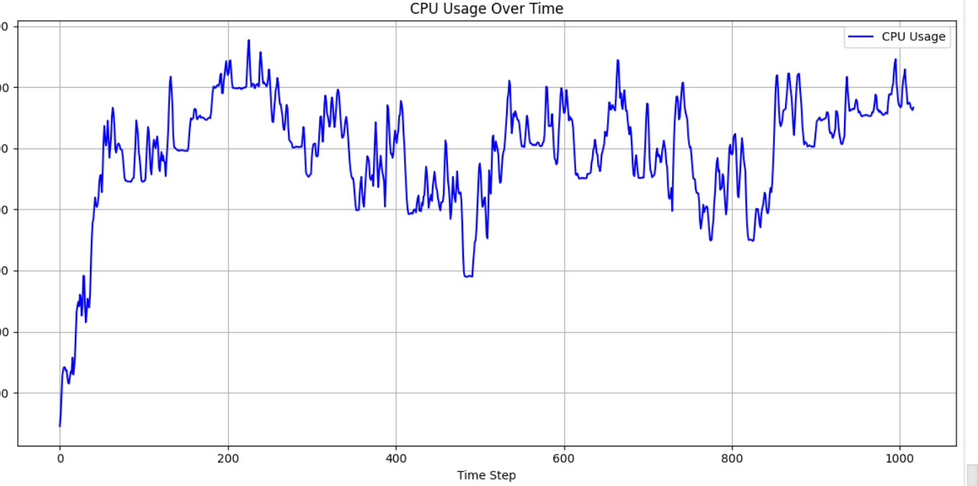
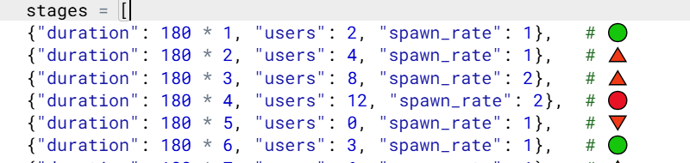
Artificial Traffic Generation
Locust to generate the Traffic
Custom Phase wise Rules
System Meta-Data
7 LLM pods
1 Web Server
Simulation period of 3 hrs
Multiple phases spread across 3 hrs with each phase lasting over 3 mins
Each Phase has 3 parameters.
a) duration - 3 mins
b) users: no of users which will be accessing the
resource
c) spawn rate: rate at which the users are spawned
until they reach to the desired users count

Slide 10
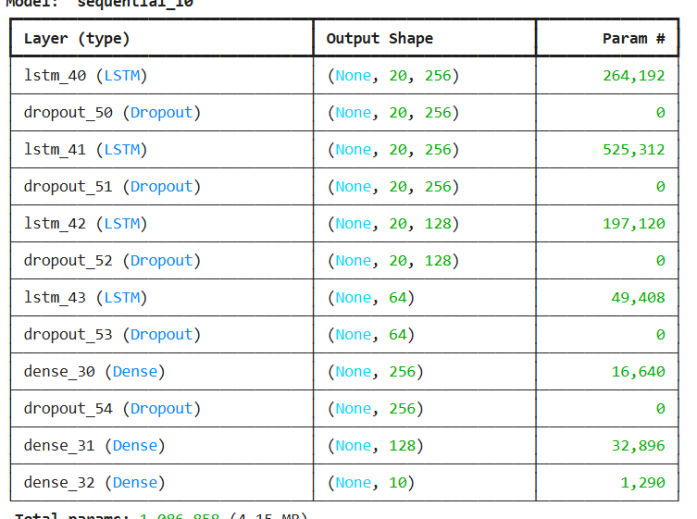
Future CPU Prediction
Models Chosen: LSTM, BiLSTM
Metrics used to test and validate: RMSE
Hyperparameters
Optimizer: Adam
Learning Rate: 0.001
Loss: MSE(Mean Squared Error)
Epochs: 100
Batch Size: 32

Slide 11
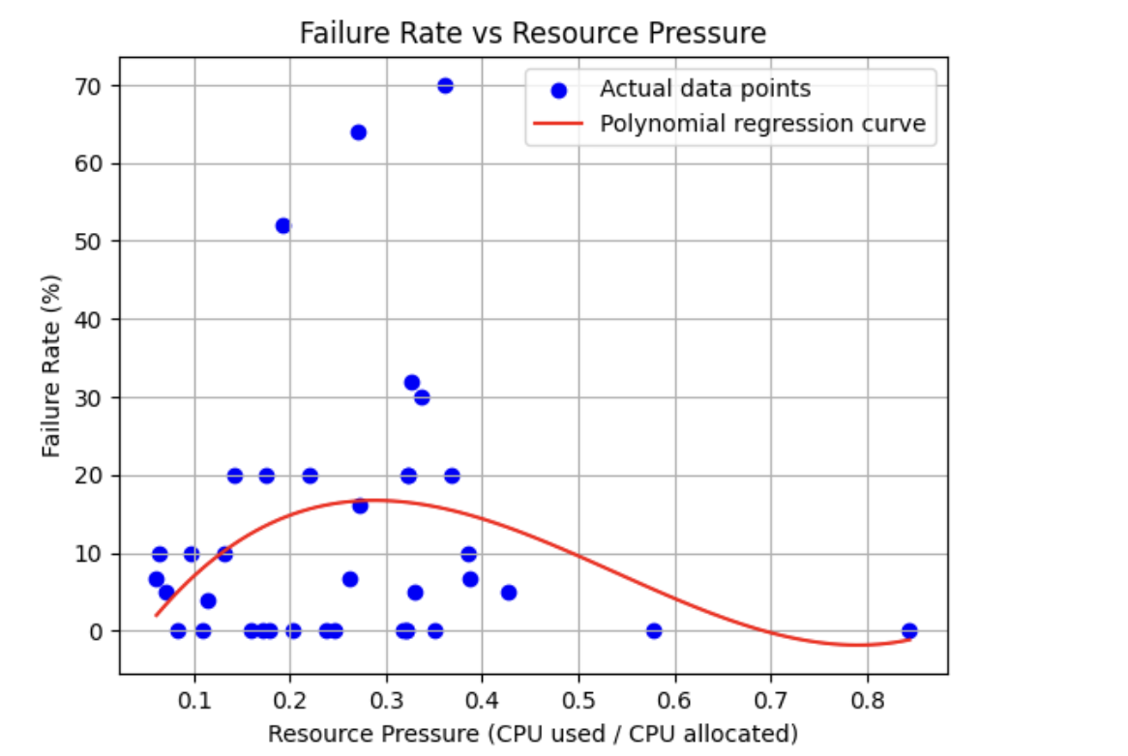
Resource Pressure Model
Predicted Resource Pressure= CPU Predicted / CPU Currently Allocated
Predicted Failure Rate = f(Predicted Resource Pressure)
If High_Resource_Pressure:
0.206= CPU Predicted/ Required CPU
Required CPU= CPU Predicted/ 0.206
Scale

Slide 12
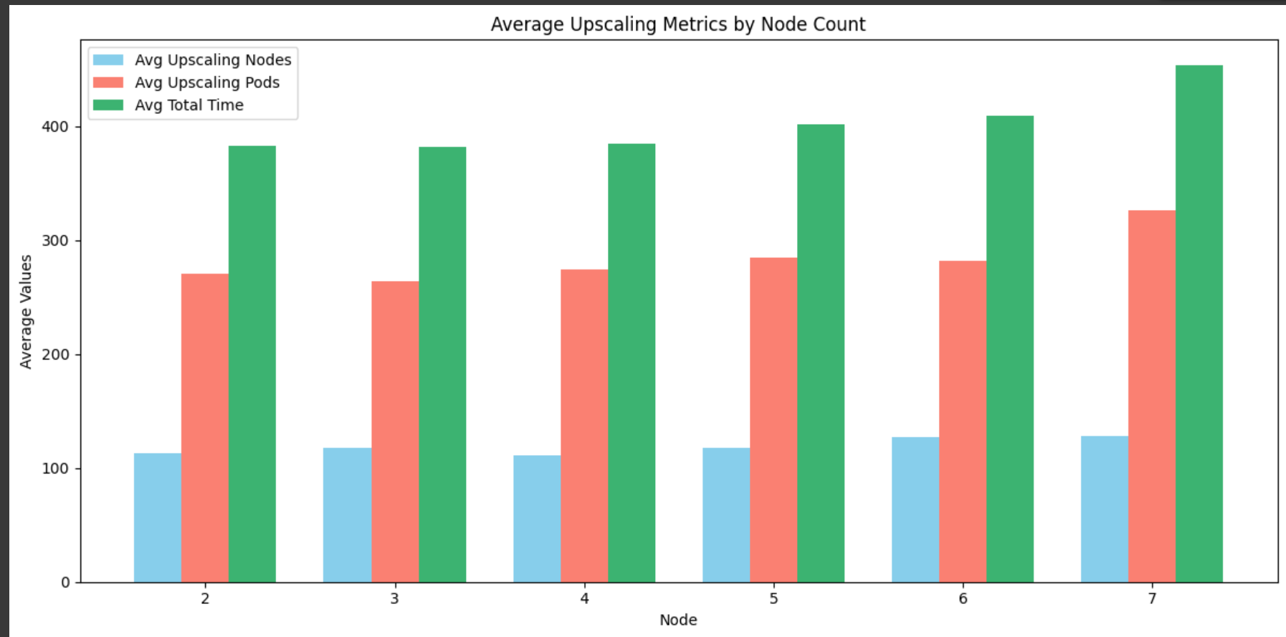
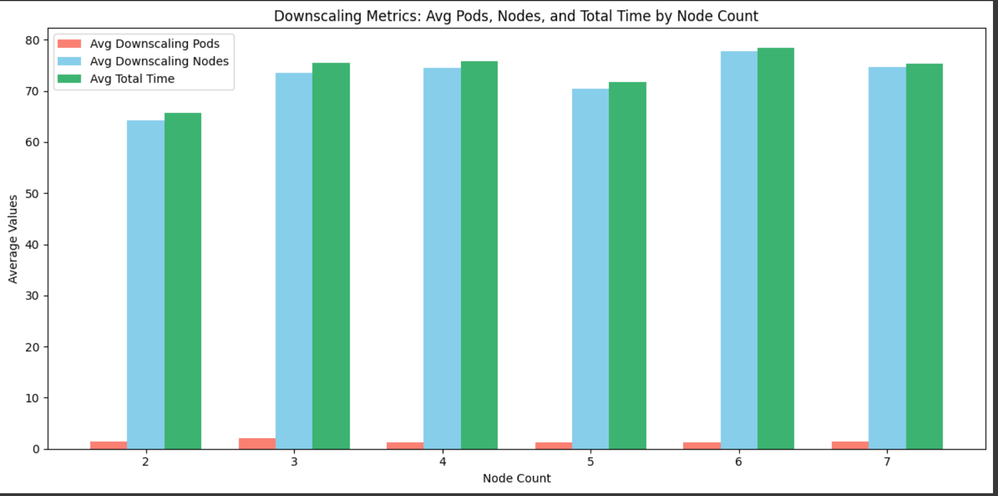
Lead Time Prediction including Nodes

Slide 13
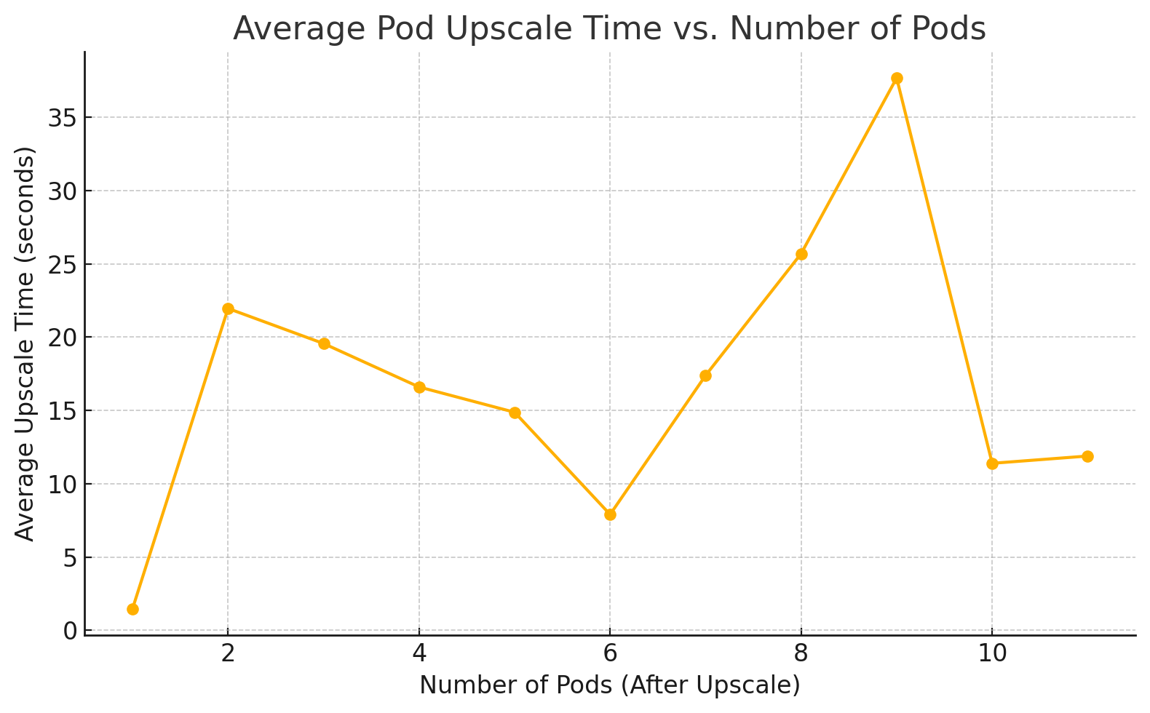
Lead Time Prediction using just Pods (Constant 8 Nodes)

Slide 14
RESULTS
Notes:
“Progress update” starts from here. give it to me

Slide 15
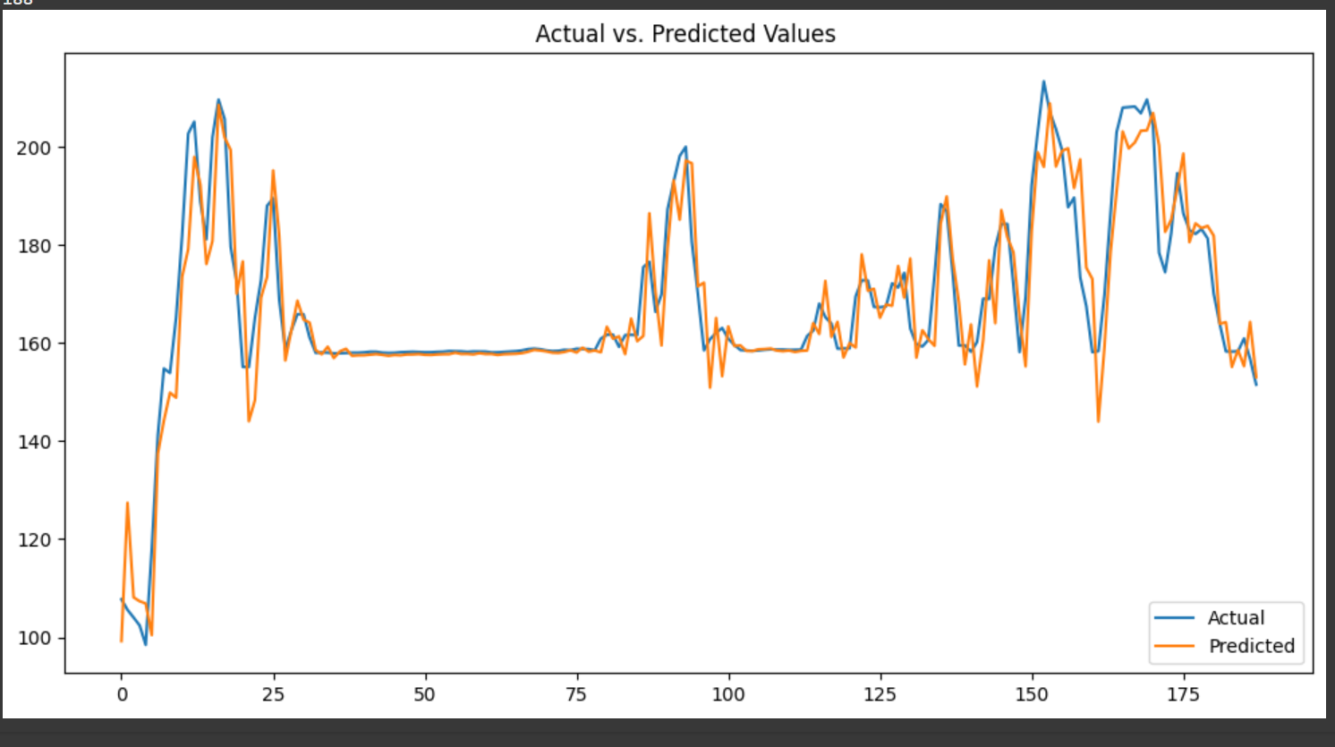
Prediction Performance on Training Data

Slide 16
Prediction Performance on Training Data

Slide 17
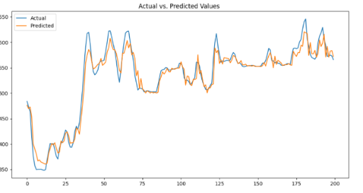
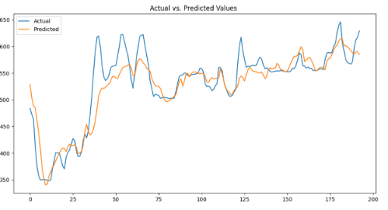
Prediction Performance with LSTM on Testing Data
6-Input Window 3 Future steps
20-Input Window 10 Future steps

Slide 18
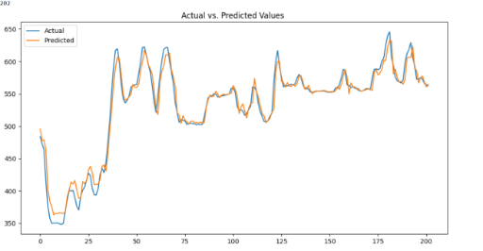
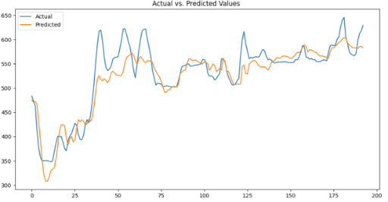
Prediction Performance with Bi LSTM on Testing Data
6-Input Window 3 Future Steps
20-Input Window 10 Future Steps

Slide 20
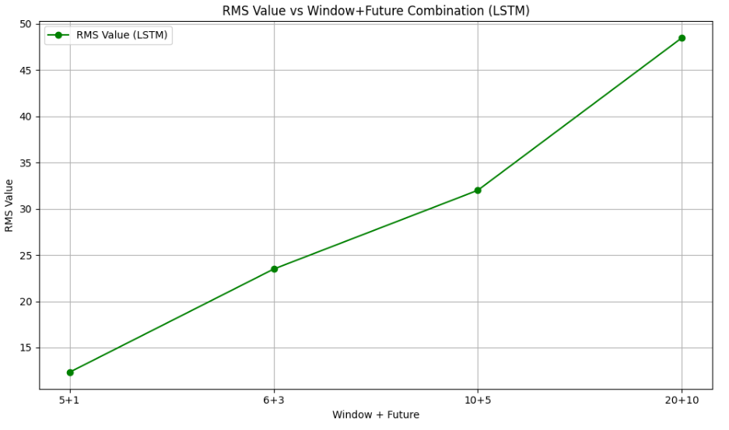
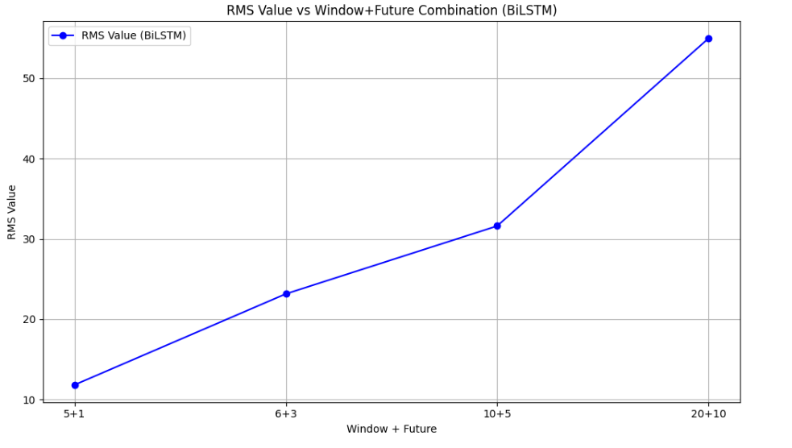
RMSE For Different Windows

Slide 21
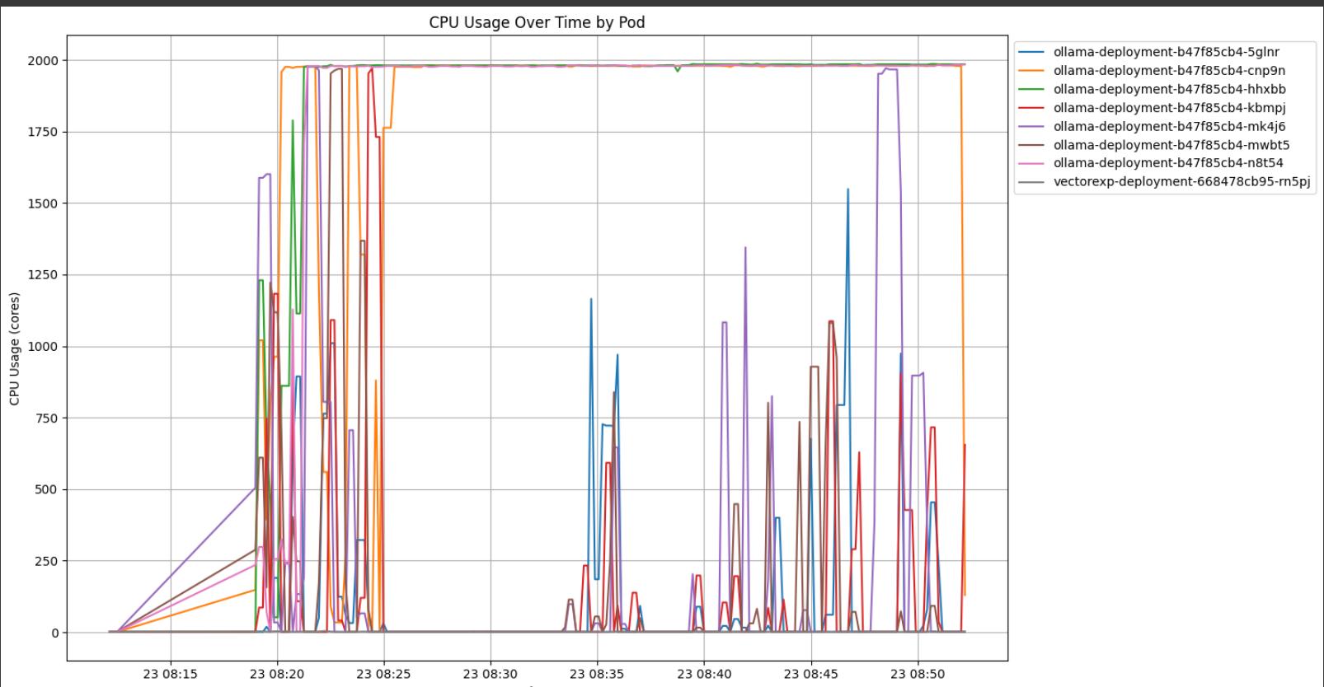
CHALLENGES
Prometheus going down when downscaling
Request Time Out Error
Lead Time Calculation
Load-Balancing amongst LLM Pods
Recreating traffic trends
Autoscaling conflict
Notes:
“Progress update” starts from here. give it to me

Slide 22
Takeaways
Tackling real-world problems by planning
Building research experiment
Lot of learning: Kubernetes, AWS, Load Balancing, Autoscaling
Notes:
“Progress update” starts from here. give it to me

Slide 23
Thank you

Slide 24
Q/A

